Slide 1
Applications of RMT in Quantitative Finance
A Survey of Principles and Associated Backtests
Using Proprietary Trading Strategies
Arjun Kilaru

Slide 2
Project Overview
In this paper, we will explore multiple trading strategies inspired by principles of random matrix theory.
Each strategy will be accompanied by a back-test on historical price data, where meaningful metrics, such as cumulative returns, will be calculated and analyzed.
Ultimately, we will understand how random matrix and linear algebra principles can be applied to systematic trading.

Slide 3
Strategy I: Application of Covariance Matrices to Achieve Desired Return Metrics
In this strategy, we will be manipulating the covariance matrices of our ticker returns to arrive at optimal weights for our portfolio.
This is primarily an exercise in mean-variance allocation and diversification.
The optimal formula penalizes securities for marginal risk (covariance) as opposed to total risk (volatility). Quantitative diversification in a portfolio (owning multiple covaried securities) is important in controlling marginal risk of a portfolio.

Slide 4
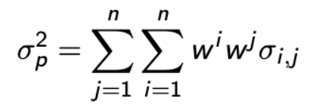
Portfolio Volatility: N assets.
With N risky assets,
Clearly, overall portfolio volatility is highly dependent on individual covariances between assets.
As portfolio managers, we seek to minimize risk while still achieving some desired mean excess return (beyond the risk-free rate, that is). This metric, Sharpe Ratio, is calculated by dividing excess portfolio return by the portfolio volatility.
Now, we will seek to find a mathematical model that captures this.

Slide 5
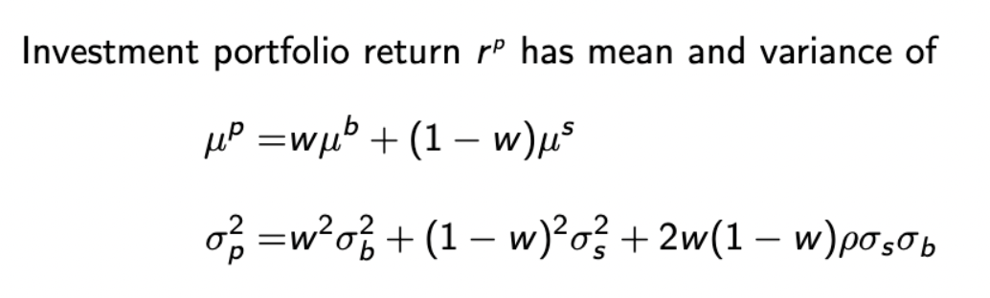
Portfolio Mean and Variance: Two Assets
Given weight w,
Weights can theoretically be any real number, but all weights must sum to 1.
If weights are beyond -1 or 1, then we are borrowing capital beyond our budget to invest in the security.

Slide 6
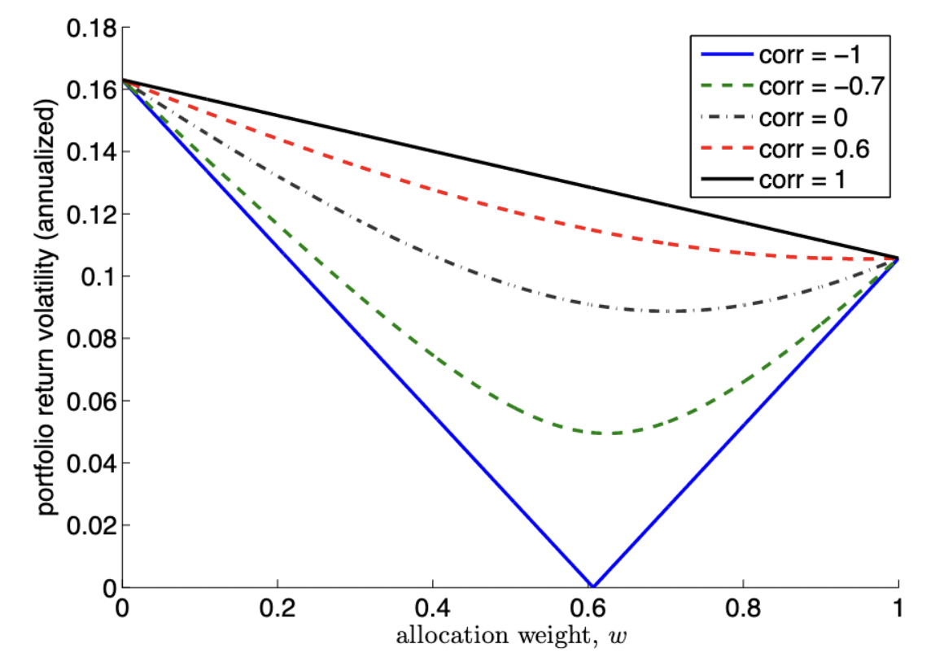
Portfolio Volatility Visualized: Two Assets

Slide 7
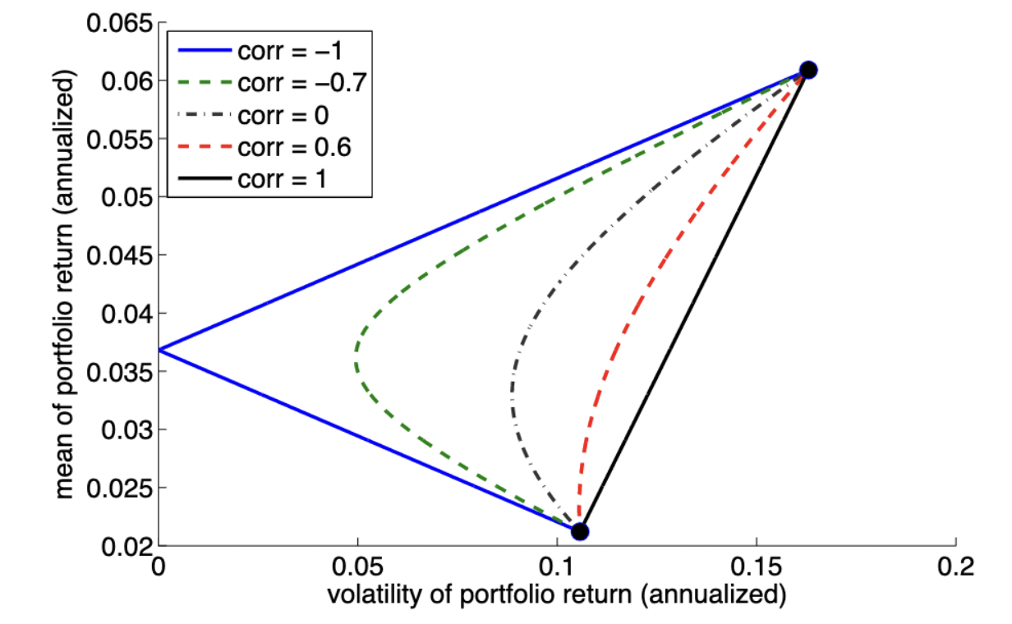
Mean-Variance Allocation: Two Assets

Slide 8
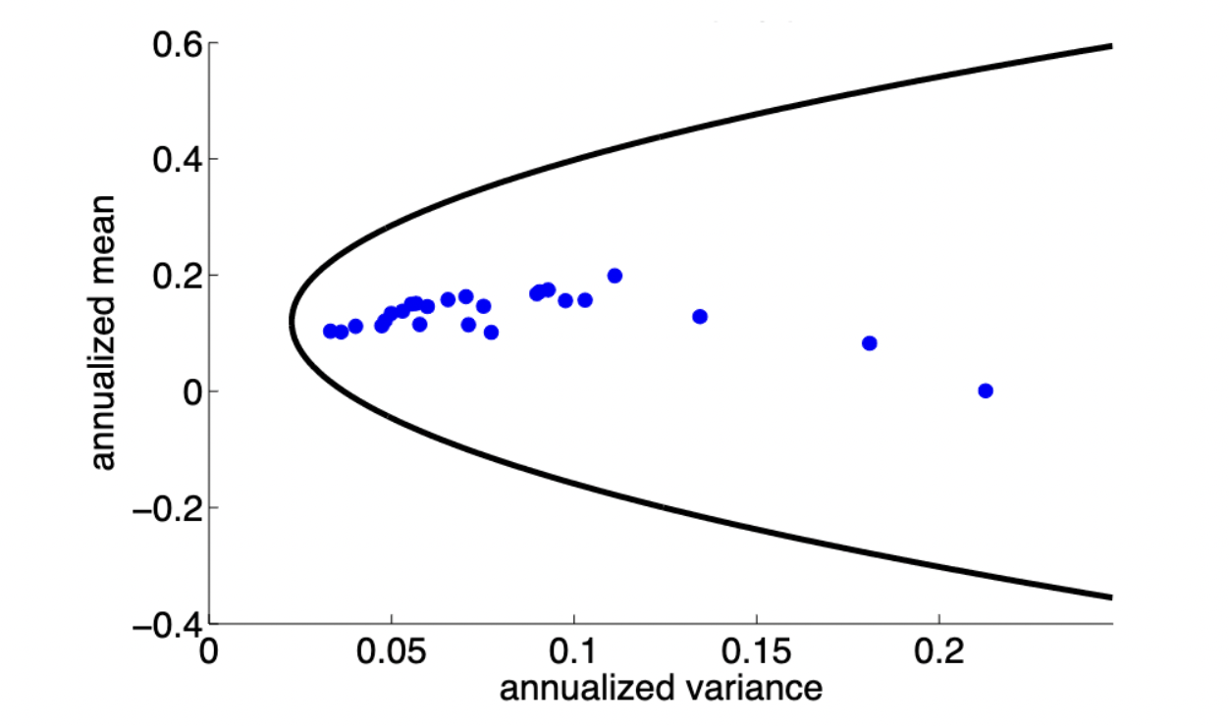
Mean-Variance Frontier
Mean-Variance frontier as visualized by 25 US-Equity Portfolios, sorted by size.
The curved segment represents efficient mean-variance optimized portfolios. These portfolios maximize mean return given a specific variance level.

Slide 9
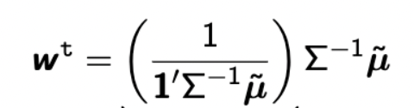
Solving for Optimal Portfolio Weights: Tangency Portfolio
Our problem can be thought of as an optimization exercise, as we seek to minimize volatility given a target mean value.
More optimally, we may seek to simply maximize portfolio Sharpe Ratio, given our asset covariance matrices.
Solving Lagrange equation yields the tangency portfolio, named after position on the MV-Frontier.

Slide 10
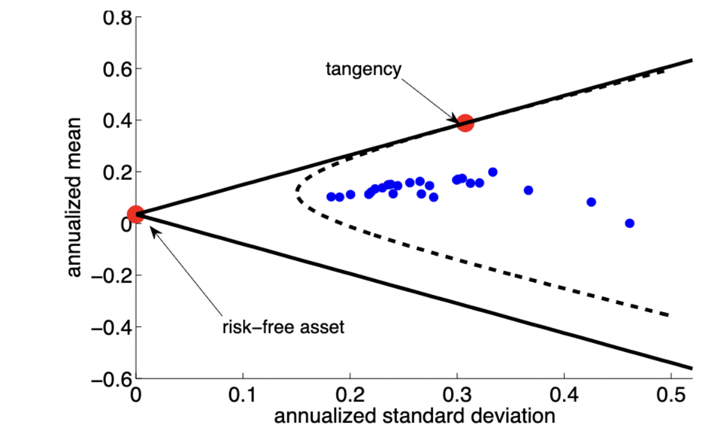
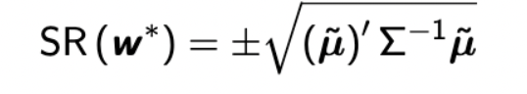
More on the Tangency Portfolio
The tangency portfolio invests 100% into risky assets, it does not invest in the risk-free asset at all.
Geometrically, the tangency portfolio lies tangent on both the MV-frontiers created with and without the risk-free asset.
As stated previously, the tangency portfolio maximizes portfolio Sharpe Ratio.

Slide 11
Tangency Portfolio: Backtested Returns
Here, we will back-test our strategy with specifications.
Our portfolio will consist of 15 total assets. Investments will be made on a quarterly basis, using weights calculated from the previous quarter.
Our 15 assets will be a combination of equities, ETFs, and bonds. Specific information can be found in the appendix.

Slide 12
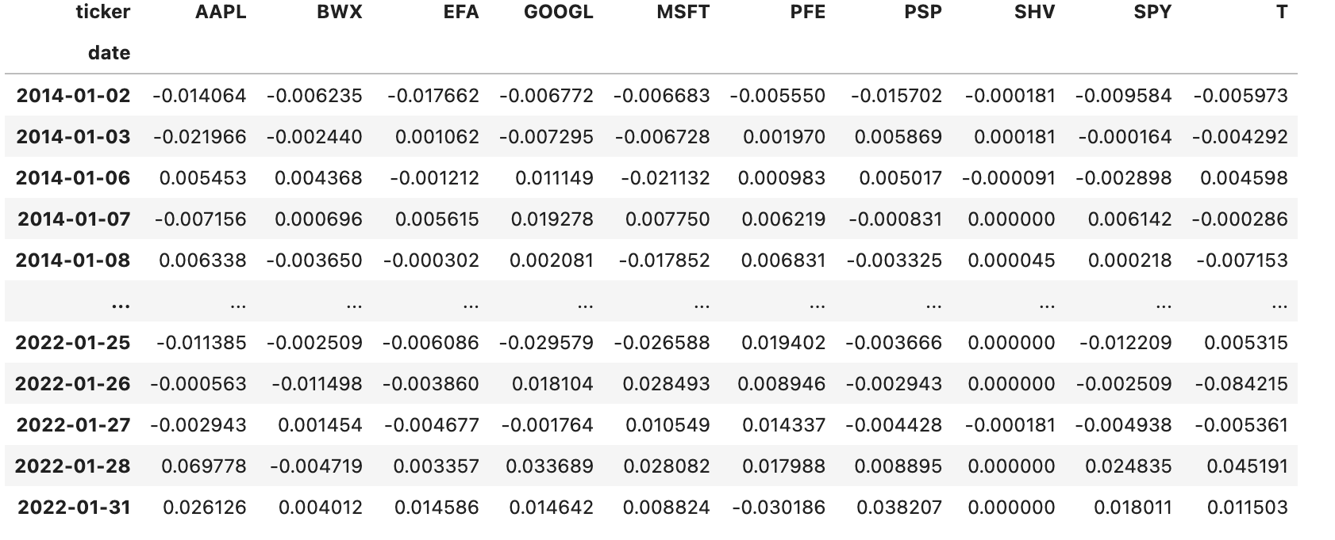
Tangency Portfolio Backtest
Here is a sample view of the data found in the tangency portfolio backtest exercise.

Slide 13
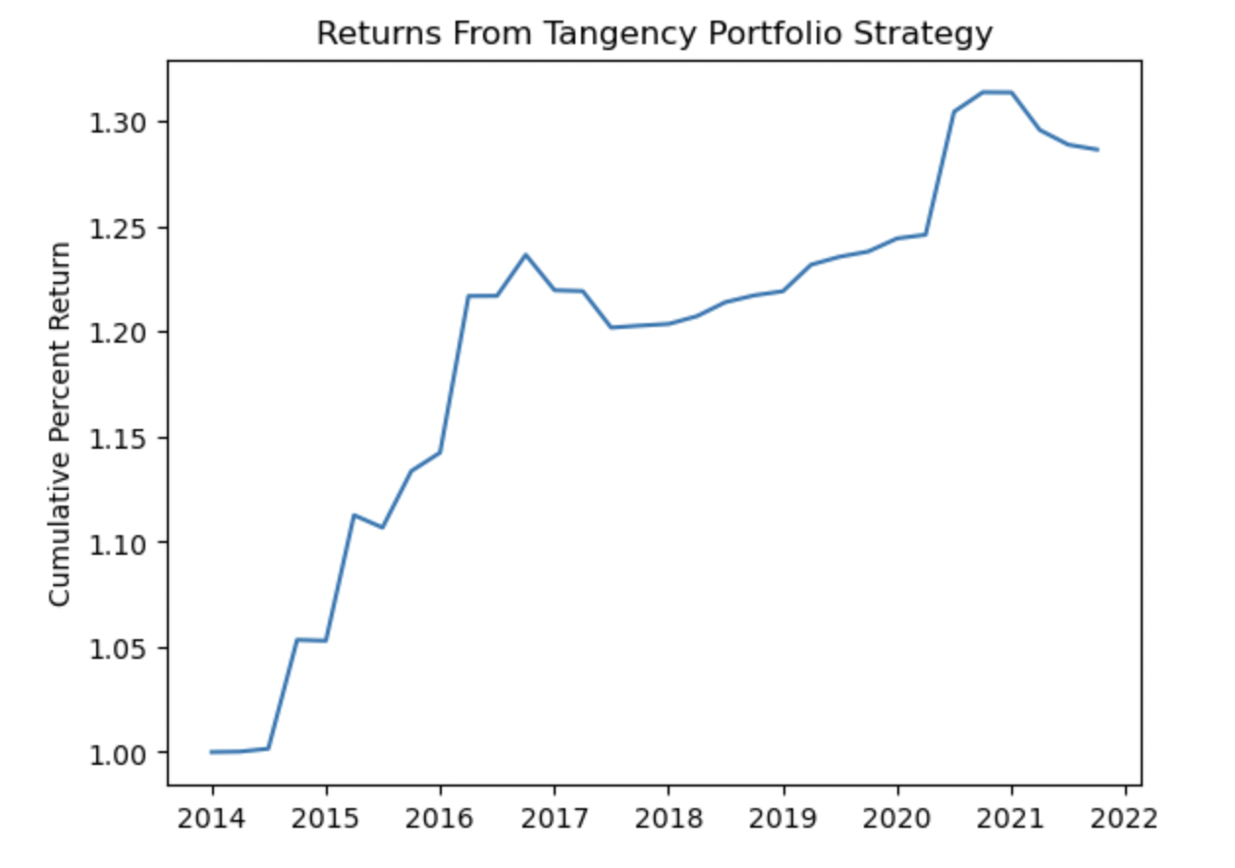
Note: performance in 2020, when all economic indicators were down. Annualized return of 3.75%
Note: many of the assets in the portfolio were fixed income, stable ETFs. For stronger returns but potentially increased volatility, adding more equities may be considered.

Slide 14
Strategy II: Application of Principal Component Analysis
Literature: Stock Trading Based on Principal Component Analysis and Clustering Analysis, IOP Conference Series: Materials Science and Engineering. Volume 740.
As discussed in class, Principal Component Analysis is a method of dimensional analysis, where data is structured into various principal components. The first principal component, which is a linear combination of column variables, captures the most variation in the dataset, and so on. PCA helps identify important variables which contribute to variation in the dataset.
Given a data matrix X, the principal components can be found by calculating the eigenvalues of the covariance matrix created by transforming X.

Slide 15
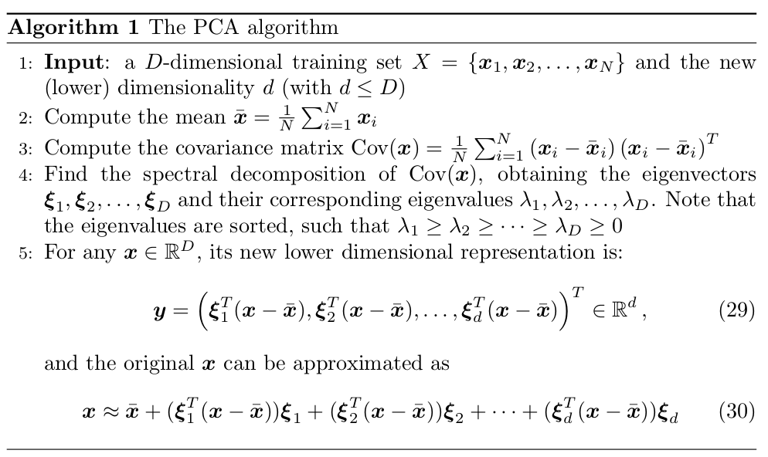
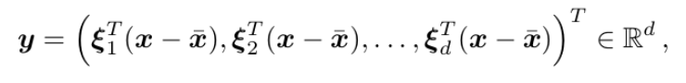
PCA Concepts: Calculation Algorithm
First, input a D-dimensional data set. Next, compute the mean vector. In data matrix terms, that is the mean of every column. Compute the covariance matrix using Compute spectral decomposition of Cov(x), obtaining up to D eigenvectors with corresponding, sorted eigenvalues. Choose d<D, as to achieve lower dimensionality. Compute This is now a lower dimensional representation of x, which can be approximated as

Slide 16
Strategy II Cont: Applying PCA to the S&P 500
Using the same quarterly frames, we can use principal component analysis to select stocks to purchase. For example, consider a dataset similar to the one used in the previous strategy, except instead of including 15 arbitrarily selected assets, we will use the entire S&P 500.
Applying PCA can help us determine which tickers are contributing the most positive variation to the SPY ETF and help us determine which tickers are contributing the most negative variation. Then, we can develop a similar buy-and-hold strategy as above and invest accordingly.

Slide 17
Strategy II Cont: Applying PCA to the S&P 500
As such, on a quarter basis, we can develop a strategy where we buy-and-hold the 5 stocks that contribute the most positive variation to the first principal component.
For now, we will use 1/n weights to allocate to each of these stocks (for simplicity) but it is also possible to adjust weights based on either the magnitude of the principal component loading or another factor.
With this strategy, you are ideally exposing yourself to the 5 highest-performing stocks, dynamically adjusting positions by the end of each quarter.

Slide 18
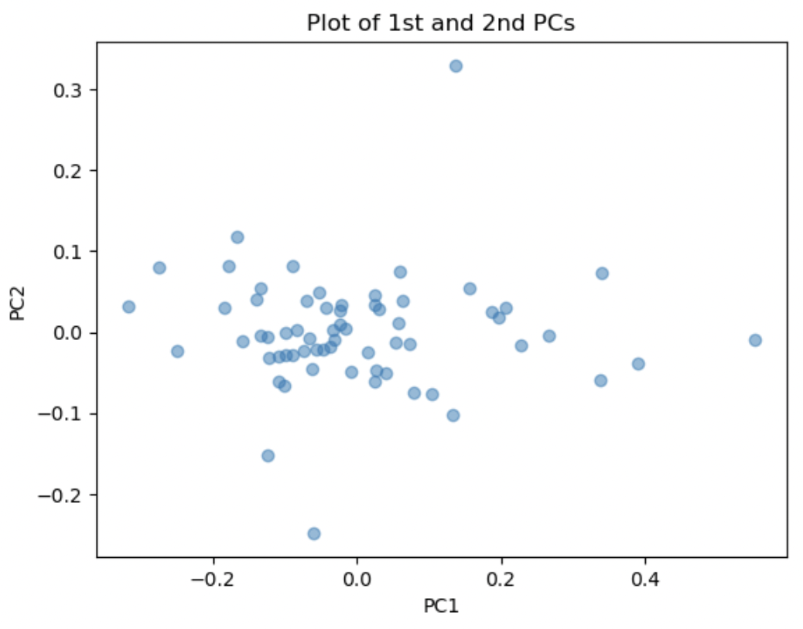
Plot of the 1st and 2nd principal components for the first quarterly frame. We can see strong variation across the first principal component. This aligns with the high variance explained by this component.

Slide 19
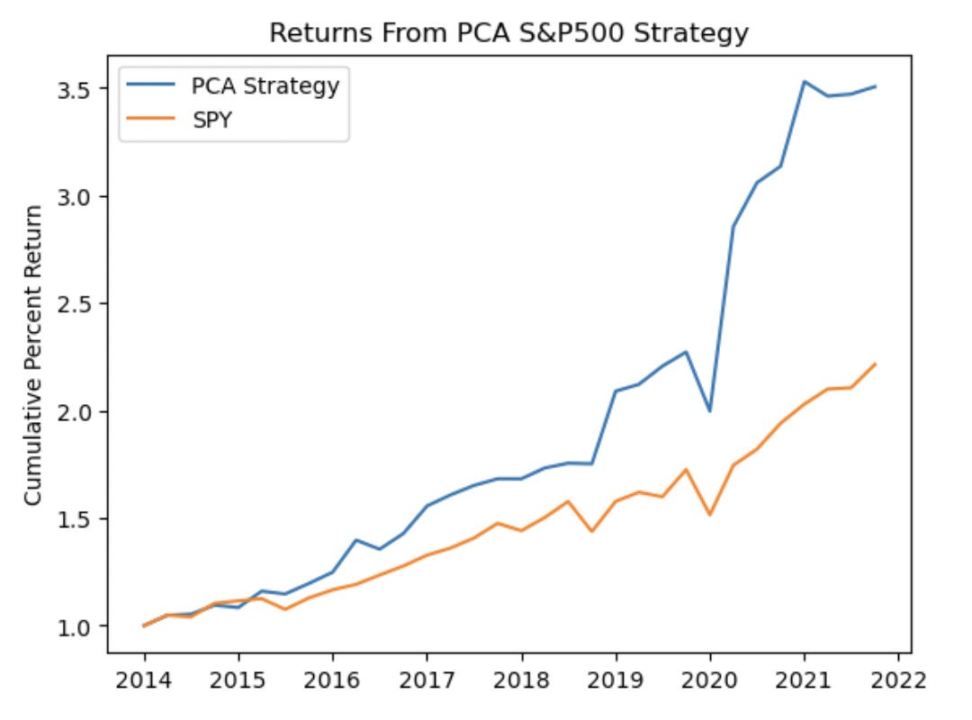
Note: near unilateral outperformance of the SPY ETF, especially in more recent years. Achieves a remarkable 31.25% annualized return.

Slide 20
Strategy III : Application of Neural Network Classifier
Literature: A Deep Neural-Network Based Stock Trading System Based on Evolutionary Optimized Technical Analysis Parameters. Procedia Computer Science. Volume 114, 2017.
An artificial neural network consists of a network of interconnected nodes, or neurons, that are organized into layers, with each layer performing a specific type of computation. The layers are typically composed of an input layer, one or more hidden layers, and an output layer.
The neurons in a neural network receive inputs from other neurons or from external sources, perform a weighted sum of the inputs, apply an activation function to the result, and produce an output. The weights of the connections between neurons are learned from data through a process called backpropagation, which involves iteratively adjusting the weights to minimize the difference between the predicted output and the true output.
There are many different activation functions we can use in our neural network. For example, in class we studied the ReLU function, and there are also logistic and exponential functions that can be used in the neural network.

Slide 21
Neural Network Concepts
To expand, a neural network is a supervised machine learning technique, containing an input layer, a number of hidden layers, and an output layer.
Each layer consists of 3 pieces of data: A matrix W, A bias vector b, and an activation function. This activation function can be the logistic function, the hyperbolic tangent, or more. As stated, we will use the ReLU.
A data vector x travels through the network,
Where each matrix, bias vector, and activation function belong to that layer.
Remark that if W_{i} is a d_{i} x e_{i} dimensional matrix, then b_{i} is a e_{i} dimensional vector and W_{i-1} must have e_{i} rows i.e. W_{i-1} is d_{i-1}x e_{i-1}with d_{i-1} = e_{i}

Slide 22
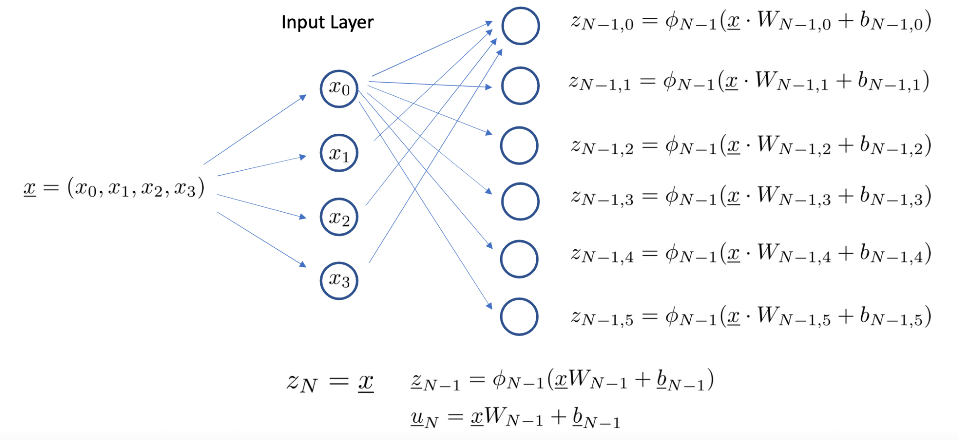
Neural Network Concepts Visualized

Slide 23
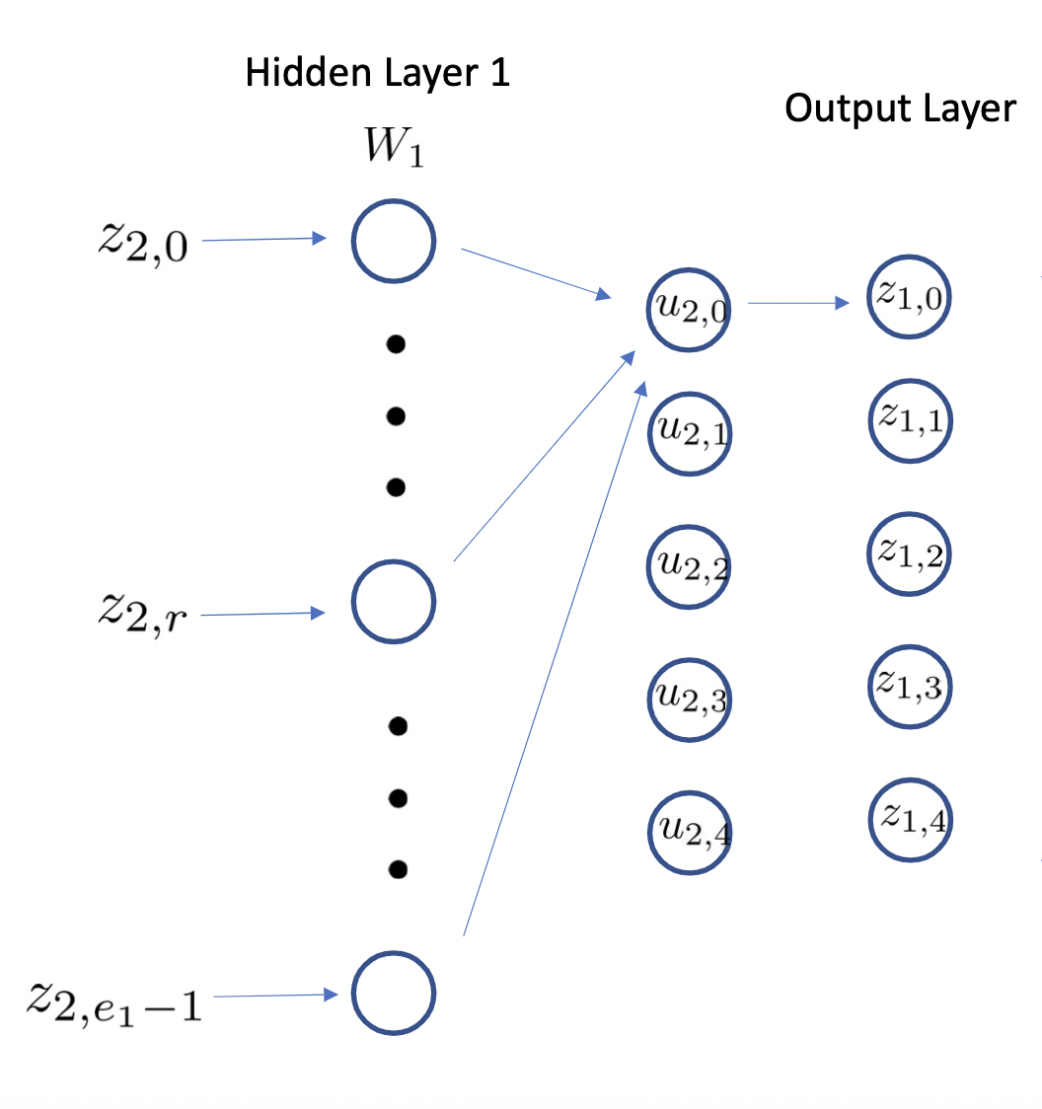
Neural Network Concepts Visualized

Slide 24
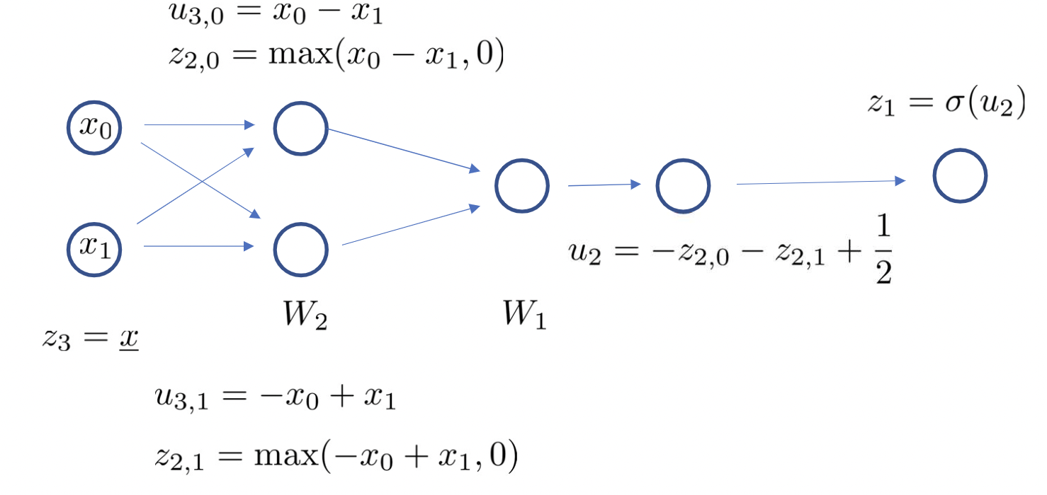
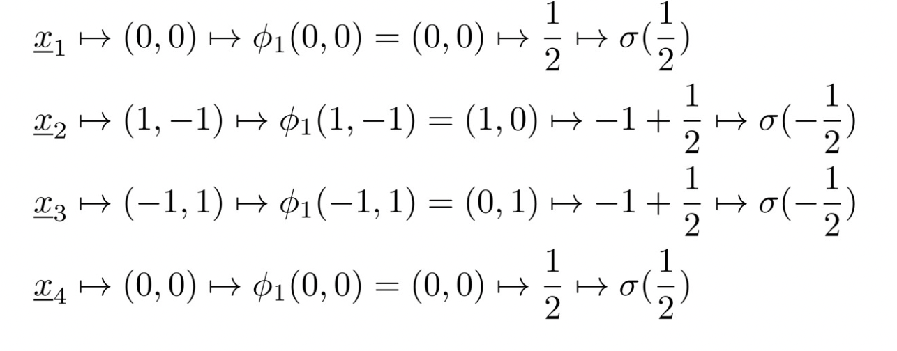
Neural Network Concepts Visualized: Simple Case
Consider an extremely simple case of neural networks, with 1 hidden layer and input dimension 2. Use logistic function for the first activation function and ReLU for the second. Set
We then have:
Consider four input vectors as given below:
x₁ = (0,0), x₂ = (1,0), x₃ = (0,1), x₄ = (1,1)
The first hidden layer can be observed below:

Slide 25
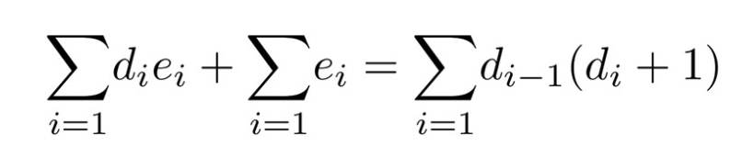
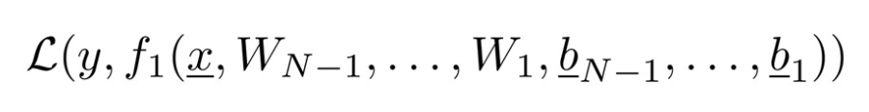
Neural Network Concepts: Parameter Estimation
How do we estimate the parameters to use in a neural network? Typically, we try and minimize a predetermined loss function. In the classification case, this loss function can be Cross Entropy, and in the regression case, this could be the Mean Squared Error.
The total number of parameters is , where d_{N-1} is the input dimension and d₁is the output dimension.
To calculate loss, we fix an input vector x and the expected output y (can be a class or real number) and consider the loss function value
We minimize loss by doing a gradient descent on the parameters.

Slide 26
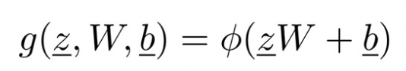
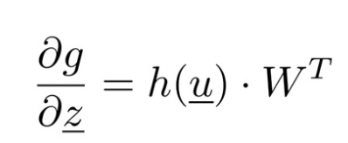
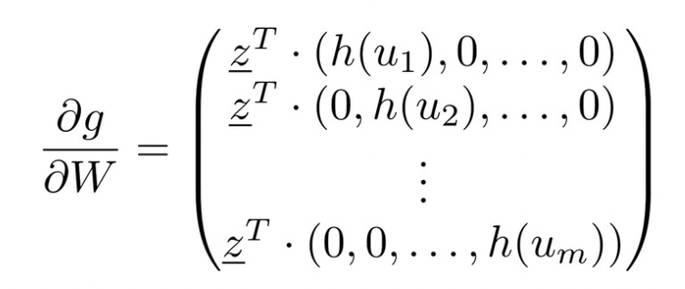
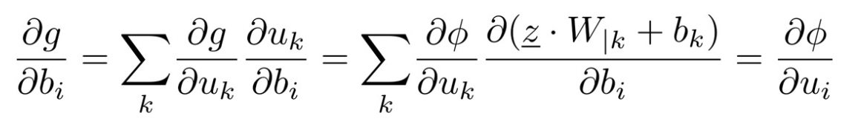
Neural Networks Concepts: Gradient Descent
We compute derivatives of our functions of the form . As a reminder, z is an n-dimensional row vector, W is an nxm matrix, b is m-dimensional.
We derive the gradient with respect to all of the parameters. To save time, we can skip to the end result (long story short, apply the chain rule across parameters).
h(u) is the Heaviside function, which is the derivative of the ReLU function.
Now, given a data point and a loss function, we can compute the gradients.

Slide 27
Neural Networks Concepts: Gradient Descent
Now, given a data point and a loss function, we can compute the gradients.
At each iteration, the gradient of the loss function is calculated using the current values of the model parameters.
The parameters are then adjusted in the direction of the negative gradient, which means that they are moved in the direction of decreasing loss. A learning rate is typically decided beforehand to regulate the magnitude of this adjustment.
Once the maximum iterations are reached or the descent algorithm converges, we have arrived at our hyperparameters for the neural network hidden layers.

Slide 28
Strategy III Cont. Neural Network Classifier Trading Strategy
Now, we will apply neural networks to algorithmic trading.
For this, we will use our largest dataset yet, similar to our price data for our other strategies, it will include a number of tickers. However, instead of only noting their prices and returns, this dataset will contain up to 731 columns, each with different identifying information on the stock at that date. This includes all fundamental ratios (debt to market cap, price to earnings ratio, etc.) as well as a number of other important company identifiers.
It is our hope to build a model that can classify whether or not a stock will outperform the market (given an associated label function).
For our neural network, we will use the ReLU activation function, the adam solver, with alpha = 1e-5. Our hidden layer sizes will be (20,20,20) and our maximum iterations are 1000.
In general, neural network parameters can be optimized using Python3 packages such as optuna, which runs hundreds of simulations to find optimal parameters.

Slide 29
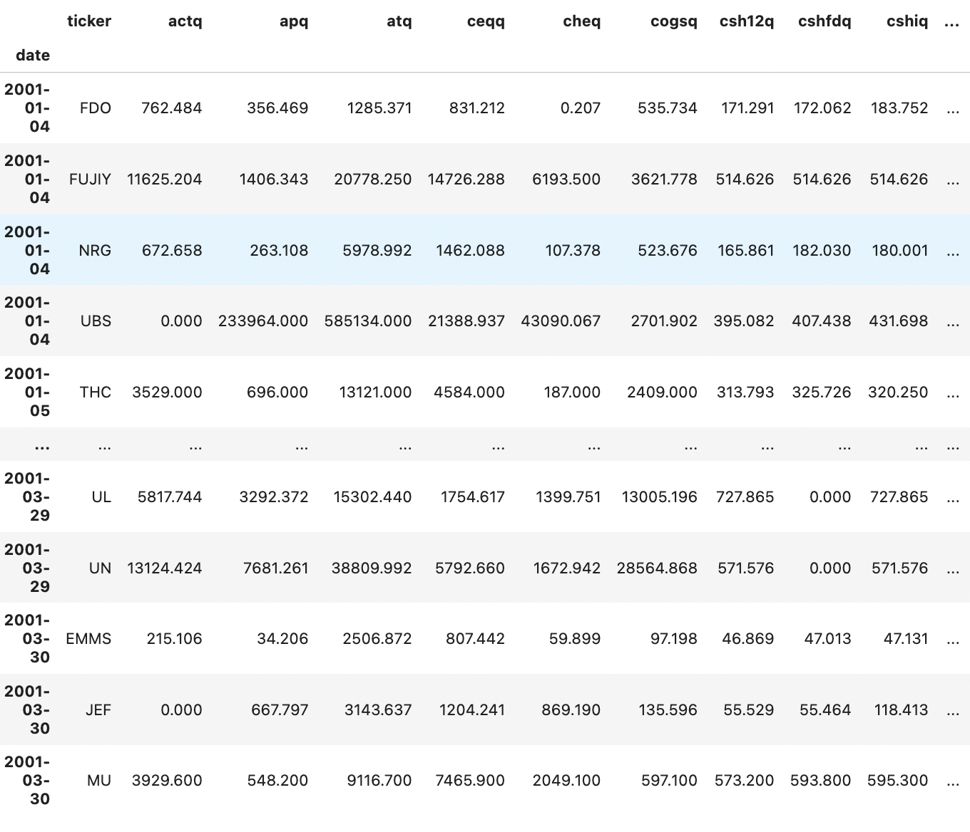
Neural Network Classifier Backtest
Here is a sample view of the data found in the neural network classifier backtest exercise.

Slide 30
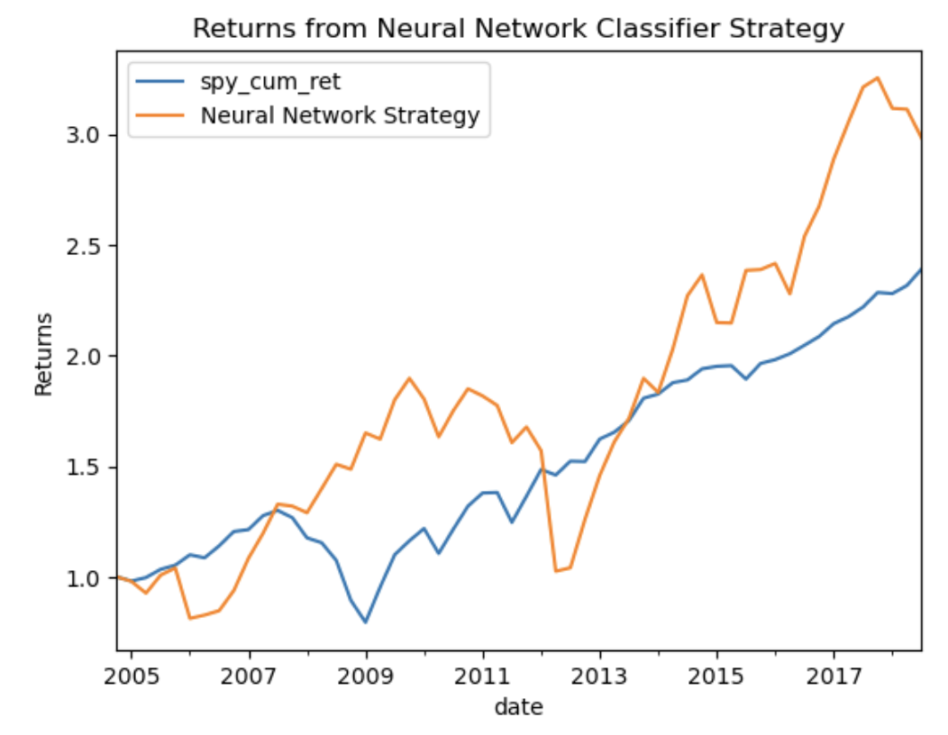
Our strategy handily outperforms the SPY, generating a 3x return over the 14-year period between 2005 and 2019. Annualized, this strategy generates a return of 15%.

Slide 31
Strategy IV : Application of Artificial Neural Networks Regression.
We can also apply Neural Network as a Regression technique, as opposed to a classification technique. Much of the terminology is similar here, in terms of specific coding.
Here, we will use information from the 500 S&P index stocks to provide a regressive prediction on the movement of the ETF in the next quarter.
Specifically, we are training our neural network on a period of 2 years. Our training set is the stock prices of all each ticker in the S&P index. Our labels are the returns of the SPY on the next day. Thus, we are using neural networks to predict tomorrow’s SPY returns given the prices of all of today’s stocks. If the prediction is positive, we buy, and if it is negative, we sell.

Slide 32
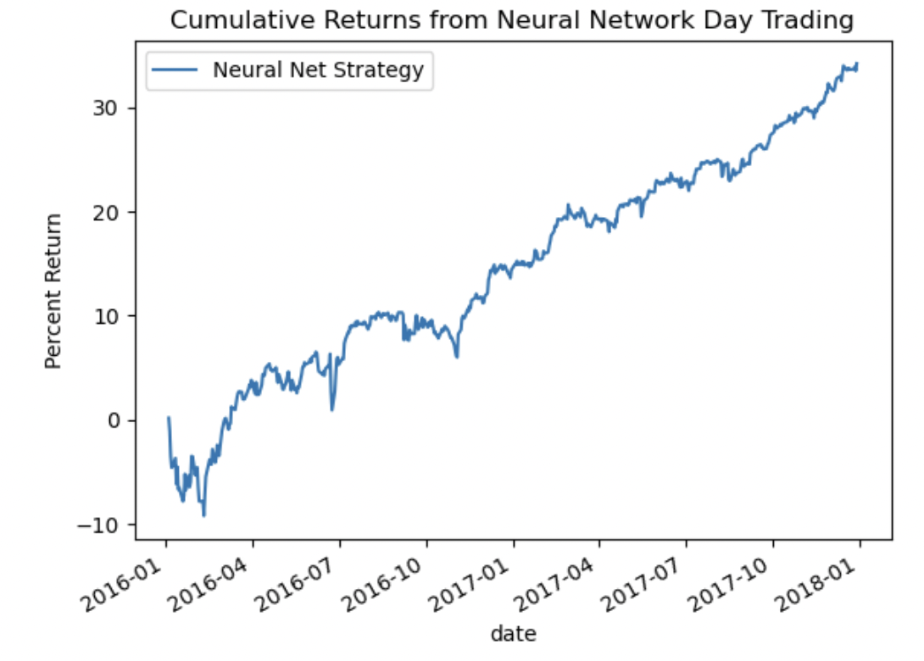
Over the two year period, this day trading strategy generates roughly 16% annualized returns, outperforming the SPY.

Slide 33
Conclusion
Using principles learning during this course on random matrices, namely covariance matrices, principal component analysis, and artificial neural networks, we have been able to devise a number of algorithmic trading strategies, many of which outperform the market and earn excess returns.
It is my hope that I was able to convey my understanding of these principles and my ability to apply them in practical, professional settings.
Thank you!

Slide 34
Questions?

